Slide 1
Tableau Project – COVID -19 India Analysis (2020 – 2023)
Name : v . DHANASEKARAN
Course : Data analysis & data science
Batch : april 2025 & an
Date : 14/07/2025

Slide 2
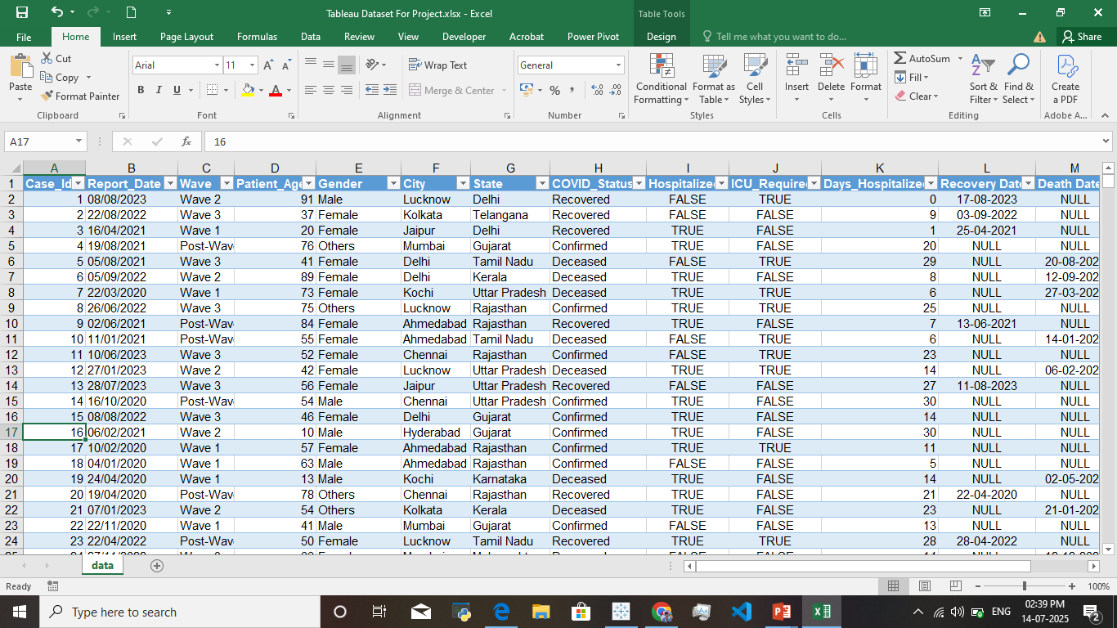
Dataset Overview :
Project Objective:
Using The Dataset To Identify The COVID – 19 Impact In India During 2020 - 2023
To Analyze An Genderwise Impacts, Most Affected States
Building An Interactive, Insightful, Dashboard Using Tableau
The Dataset Created Using The Makaroo Website
In This Dataset Contains The COVID – 19 Pandemic Period 2020 -2023
The Dataset Contains Patient Id, Age, City, State, Report Date, Gender , Etc..,
It Also Contained The Patient Recovery Date And Death Date

Slide 3
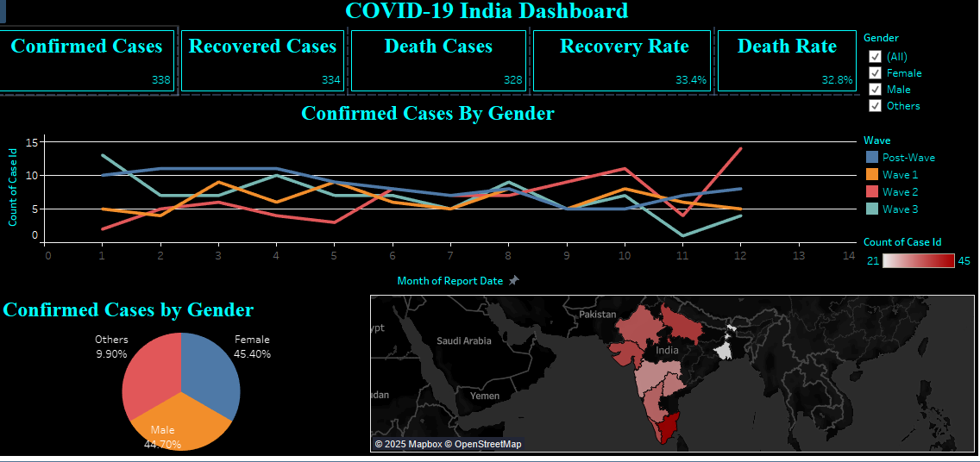
Dashboard Overview :
KPI Cards – Total Confirmed , Recovered , Death Cases And Recovery , Death Rate
Line Chart – Using The Line Chart To Visualize The Gender And Wave By Confirmed Cases
Pie Chart – To Visualize The Genderwise Confirmed Cases
Map – Visualize The Number Of Death By State

Slide 4
Key Insights :
Wave 2 And Post-wave Are The Most Confirmed Cases Occurred During 2020 – 2023
Male And Female Gender Are Nearly Equally Impacted
Tamilnadu, Maharastra And Utter Pradesh Are The Highest COVID-19 Deaths
The West Bengal Has The Least Number On Deaths Were Ocuured
The Recovery Rate Is About 33.4% And Death Rate Is About To 32.8%

Slide 5
Recommendations:
To Improve The Insights Through The Data’s Like Vaccination Status Help To Find The Recovery And Death Rate Across The Waves
Include The Hospital Availability And The Resources(like Beds, Oxygen Cylinder ,ICU Rooms)were Before Next Wave
To Improve The Dataset Using District Level Analyze To Get An More Informations
Applying An Forecast Techniques To The Future Predictions And Advanced Analysis
Thank You !

Slide 6
Any questions ?

